Slide 1

Ukiah Valley Groundwater Sustainability Plan: Community Outreach Meeting
DRAFT
Ukiah Valley Basin Groundwater Sustainability Agency
September 29, 2020

Slide 2
Introduction

Slide 3

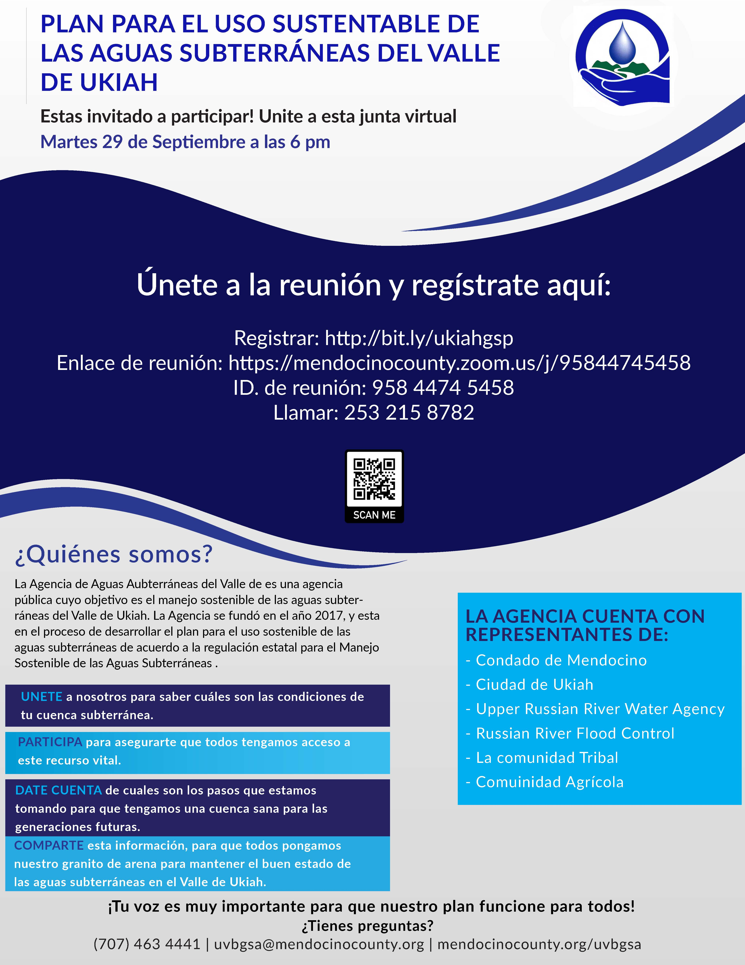
Welcome!

Slide 4
Meeting Format and Remote Meeting Protocols
Mute your Microphone
  To help keep background noise to a minimum, make sure you mute your microphone when you are not speaking.
  To unmute on your phone dial *6
How to switch to Spanish/English
  Click the Interpretation “globe” icon at the bottom of the screen
  Click the language you want to hear (i.e., Spanish or English)
  Click “Mute Original Audio” to silence all other languages
  Note: If interpretation is in progress, all languages will be heard if either language selection is Off, or if Mute Original Language is Off.
Asking Questions
  Click Raise Hand in Webinar Controls
  By Phone dial *9 to raise your hand

Slide 5
Meeting Agenda
INTRODUCTION
  Welcome
  Introduction to Meeting Format/Remote Meeting Protocols
  Overview of Meeting Agenda
  Message from the Chair
GOVERNANCE
  Introduction to Ukiah Valley Groundwater Sustainability Agency
  Introduction to SGMA
  Q&A
PUBLIC ENGAGEMENT
  Introduction to Communication and Engagement Plan
  Q&A
GSP TECHNICAL PROCESS
  Introduction to GSP
  Overview of GSP content
  Current status of technical work
  Planned next steps and schedule
  Q&A
NEXT STEPS
  GSA and Technical Committee Meetings
  Next Public Meeting

Slide 6
Terms and Acronyms
GSA – Groundwater Sustainability Agency
UVB – Ukiah Valley Basin
GSP – Groundwater Sustainability Plan
MO – Measurable Objectives
MT – Minimum Threshold
SGMA – Sustainable Groundwater Management Act
SMC – Sustainable Management Criteria
TAC – Technical Advisory Committee
UR – Undesirable Result

Slide 7
Governance

Slide 8
  Introduction to UVBGSA
Carre
Brown
Ukiah Valley Basin GSA
County of Mendocino
City of Ukiah
Russian River Flood Control and Water Conservation Improvement District
Upper Russian River Water Agency
Agricultural Representative
Tribal Representative
Douglas F.
Crane
Brandi
Brown
Richard
Mack
Zachary
Robinson
Alfred
White

Slide 9
  Introduction to UVBGSA: Organization and Team Structure
Groundwater Sustainability Agency
County of Mendocino
City of Ukiah
Technical Advisory Committee
County of Mendocino
City of Ukiah
Technical Team
Larry Walker Associates
GEI
Working Groups
RRFCD
Tribal Rep.
URRWA
Agricultural Rep.
Sonoma Water
URRWA
RRFC
Tribal Rep.
Agricultural Rep.
MCRCD
CLSI
SCI
UC Davis
Subject Matter Experts

Slide 10
Technical Advisory Committee (TAC) Members
Name | Organization
Glenn McGourty, Chair | County of Mendocino
Sean White | City of Ukiah
Elizabeth Salomone | Russian River Flood Control
Sonny Elliot, Jr. | Tribal Representative
Levi Paulin | Agricultural Representatives
Don Seymour | Sonoma Water
Mike Webster | Mendocino County RCD
Laurel Marcus | California Land Stewardship Institute

Slide 11
Roles and Responsibilities
GSAs: have authority and responsibility for GSP and content within
TAC: members provide advice, input, and recommendations to the GSAs on all aspects of the GSP
Technical Team: researches technical issues, prepares draft content for the GSP
Working Groups: provide subject-specific advice, input, and recommendations to the Technical Team and TAC

Slide 12







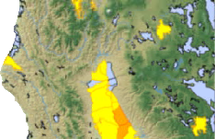
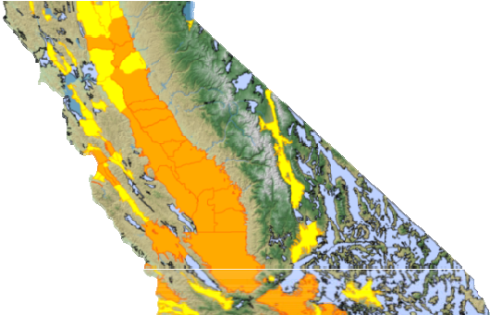
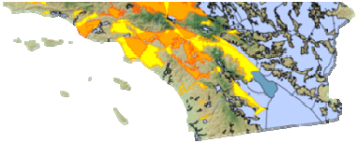
Introduction to SGMA (Sustainable Groundwater Management Act)
4
Sustainability
Avoid Six Undesirable Results
Groundwater Sustainability Plans Required for High and Medium Priority Basins by 2020/22
Historic drought
Became law on January 1, 2015
Medium/high priority basins must be managed sustainably
Emphasis on local control with State oversight
  State intervenes if local action not taken
Requires Groundwater Sustainability Agencies (GSAs)
Requires Groundwater Sustainability Plans (GSPs)

Slide 13
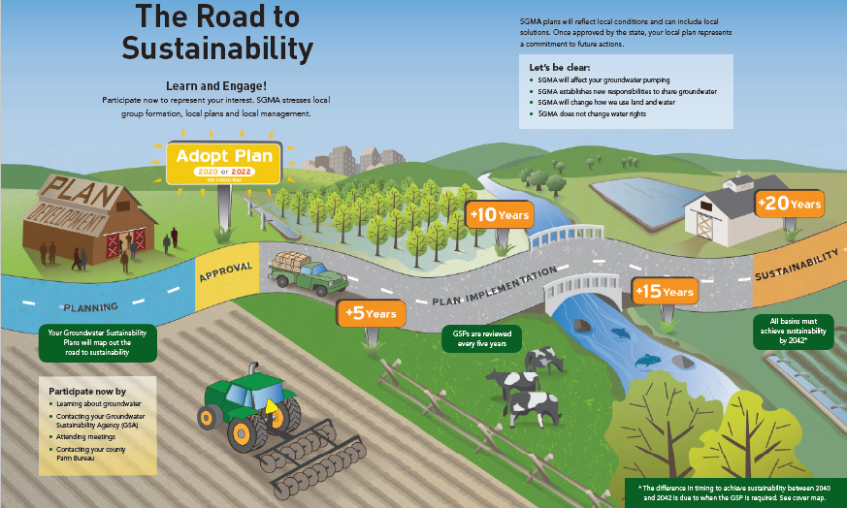
LEARN and ENGAGE! Participate NOW to represent your interest! SGMA stresses LOCAL group formation, LOCAL plans, and LOCAL management!

Slide 14
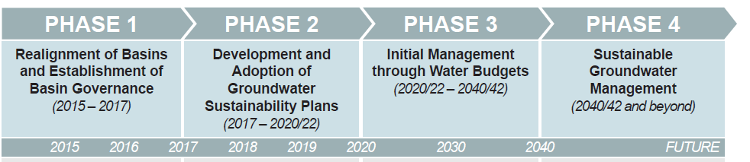
More in details: Phases to Implement SGMA
First Step: forming a Groundwater Sustainability Agency (GSA)
  By June 2017 → done
Second Step: developing a Groundwater Sustainability Plan (GSP)
  January 2022

Slide 15
Summary
Key to SGMA success → GSP accepted by DWR and local stakeholders, based on
  Local management,
  Outreach effort and community involvement,
  Good science, and data collection
Need to support GSAs in overcoming challenges and develop opportunities

Slide 16
Q&A & Poll
Ukiah
Public
SGMA

Slide 17
Public Engagement

Slide 18
Why the Public Should Be Engaged?
Water is vital to the economy, the environment, and the quality of life
Groundwater is a major irrigation and municipal resource in Ukiah Valley
All of us need to promote the health and longevity of our shared and valued resource
A better plan with more trust and support can be developed
Decision-making and actions will improve leading to better impacts and outcomes

Slide 19
Goals of the Communication and Engagement Plan (C&E Plan)
Inform the public with balanced information
Consult with the public by obtaining feedback and public comments on analyses and decisions.
Involve beneficial users and work with them throughout the process to ensure that their concerns, aspirations, and their overall input is understood and considered.
Collaborate with stakeholders in the decision-making process.
Inform all engaged on how their input affected the decision.

Slide 20
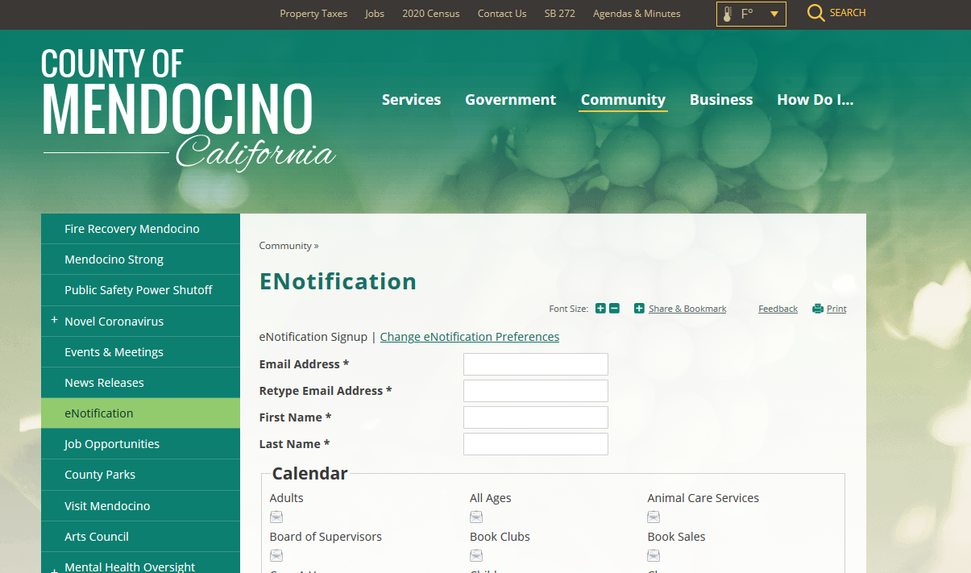
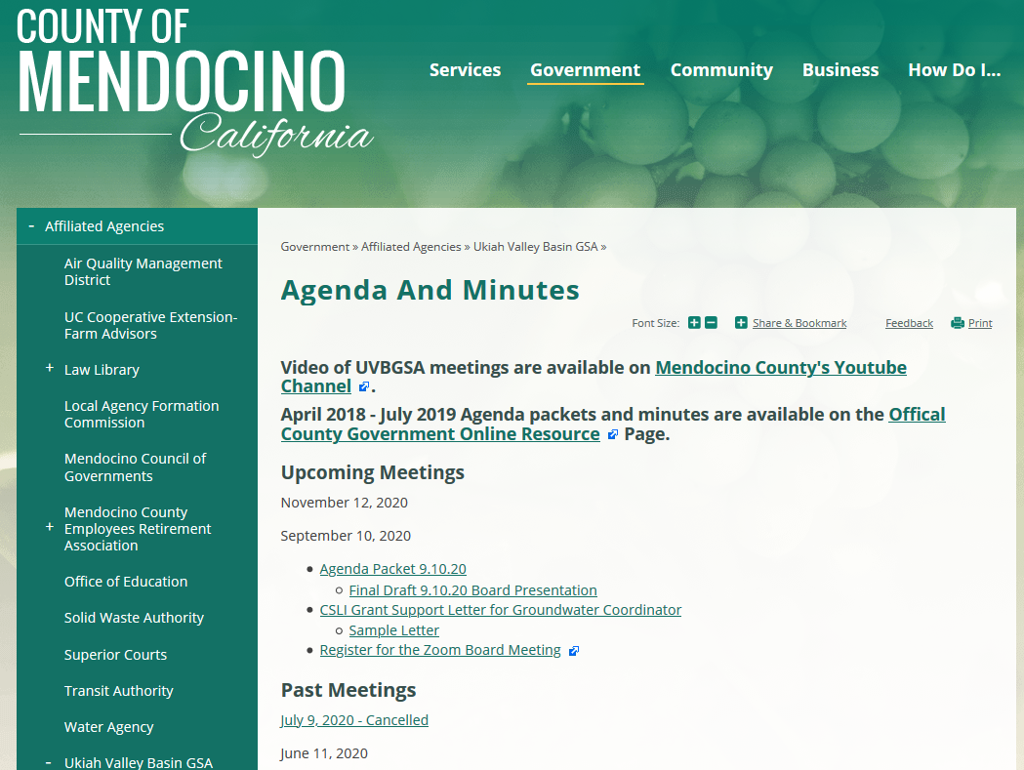
Venues for Engagement
Sign up for Interested Parties List
  You can use County e-Notification System
  https://www.mendocinocounty.org/community/enotification
Attend Board and TAC Meetings
  Find dates, agendas, minutes, and presentation materials on County website
  You will be notified if you signed for interested parties list
Receive, review, and comment on public drafts of chapters
Attend Public and Community meetings

Slide 21
Venues of Engagement for Public: Get Involved
Typically, 2nd Thursday of the month from 1:30-3:30PM
Typically, 2nd Wednesday of the month from 1:30-3:30PM
Look for similar posters and eblasts
Contact us if you are proficient in the subject and want to get involved
UVBGSA Board Meetings
12 November 2020
14 January 2021
TAC Meetings
12 November 2020
14 January 2021
14 October 2020
Community Meetings
Dec-Feb (TBD)
After March 2021 (TBD)
Possible Additional Meeting after June
Working Group Meetings
SW/GW Interaction
PVP Operations
Ag representatives (Farm Bureau)
Others?

Slide 22
Q&A and Venue Preference Poll
Ukiah
Public
SGMA

Slide 23
GSP Technical Process

Slide 24
GSP Development Schedule
SEP 2020 THROUGH JAN2021
Calibrated Integrated Model
Plan Area & Basin Setting
FEB 2021 THROUGH JUNE 2021
Sustainable Management Criteria
JULY 2021 THROUGH JAN 2022
Review and Commenting Process
Historical and Current Water Budgets
Future Baseline and Climate Change Scenarios
Projects and Management Actions
Implementation Plan
Draft GSP
Public Meeting and Public Review
Revised Draft
GSP Submittal and Adoption

Slide 25





Plan contents and current status
A GSP has five chapters:
Introduction
Plan Area and Basin Setting
Sustainable Management Criteria
Projects and Management Actions
Plan Implementation

Slide 26
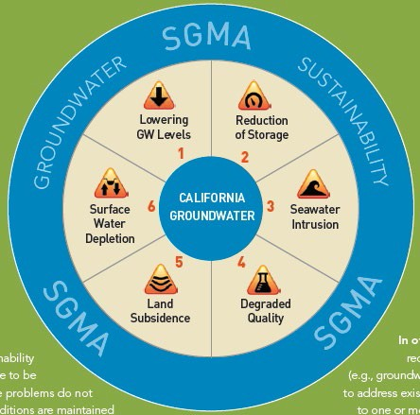
Sustainability Indicators: Learning a New Language
6
Sustainable Management Criteria and Projects and Management Actions are the Key Components of the GSP:
GSP needs to consider and demonstrate the applicability (or not) of all the sustainability indicators
We will focus on: lowering groundwater levels, reduction of storage, degraded quality, and surface water depletion
Monitoring networks to characterize and inform sustainability indicators

Slide 27
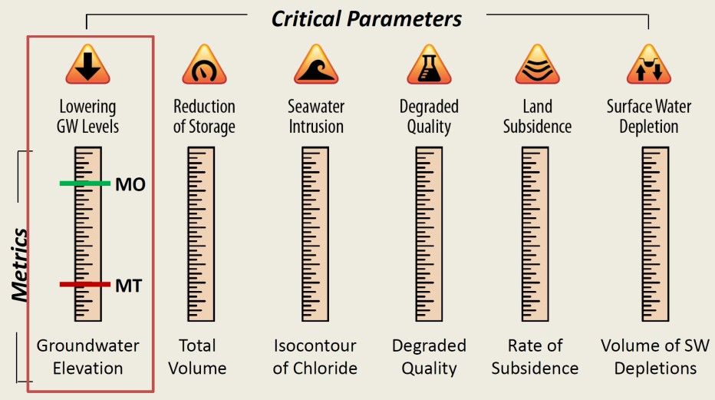
Developing “Thermometers” to Gauge the Health of the Basin for Each Applicable Undesirable Result
Sustainability Indicators
Measurable Objective: Goal that we want to strive for.
Minimum Threshold:
  Quantitative value reflecting what is significant and unreasonable. The line we don’t want to cross.
Measurable Objective (MO)
Monitoring
Min/Max Threshold (MT)
modified from Ca DWR 2016

Slide 28
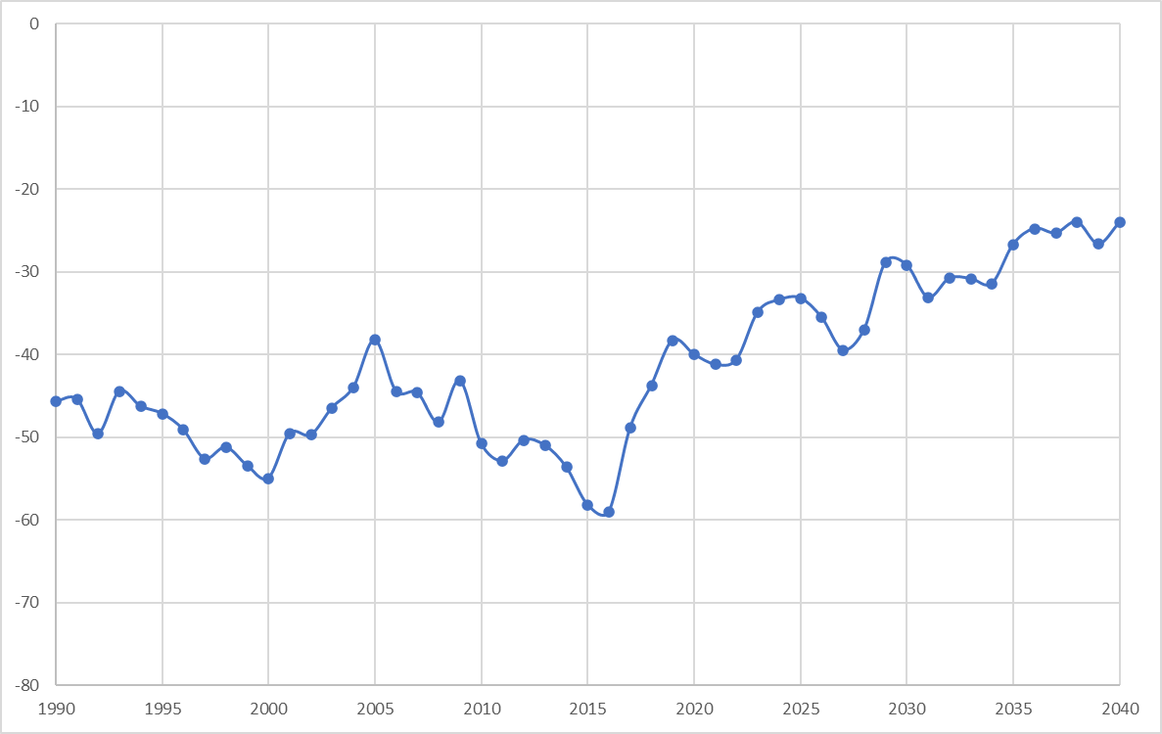
Review of Sustainable Management Criteria Components
Undesirable Results
Minimum Thresholds
Measurable Objectives
Sustainability Goal
DRAFT EXAMPLE – Groundwater Levels
Measurable
Objective
Groundwater Level
Trigger
Minimum Threshold
Undesirable
Result
1990
2000
2010
2020
2030
2040
Year
Notes:
Sustainability Goal: “Each Agency shall establish in its Plan a sustainability goal for the basin that culminates in the absence of undesirable results within 20 years of the applicable statutory deadline.”
Undesirable Results: “Undesirable results occur when significant and unreasonable effects for any of the [six] sustainability indicators (SIs) are caused by groundwater conditions occurring throughout the basin.”
Minimum Thresholds (MT): “The numeric value used to define minimum thresholds shall represent a point in the basin that, if exceeded, may cause undesirable results.”
Measurable Objectives (MO): “Measurable objectives shall be established for each SI, based on quantitative values using the same metrics and monitoring sites as are used to define the minimum thresholds. They shall provide a reasonable margin of operational flexibility under adverse conditions.”

Slide 29
Review of Sustainable Management Criteria Components
Undesirable Results
  Must be “Significant and Unreasonable”
  Statement that describes conditions that we do not want to happen
  Defined for each sustainability indicator
    (e.g. groundwater levels, groundwater quality, etc.)
DRAFT EXAMPLE – Groundwater Levels
Measurable
Objective
Groundwater Level
Trigger
Minimum Threshold
Undesirable
Result
1990
2000
2010
2020
2030
2040
Year
Notes:
Sustainability Goal: “Each Agency shall establish in its Plan a sustainability goal for the basin that culminates in the absence of undesirable results within 20 years of the applicable statutory deadline.”
Undesirable Results: “Undesirable results occur when significant and unreasonable effects for any of the [six] sustainability indicators (SIs) are caused by groundwater conditions occurring throughout the basin.”
Minimum Thresholds (MT): “The numeric value used to define minimum thresholds shall represent a point in the basin that, if exceeded, may cause undesirable results.”
Measurable Objectives (MO): “Measurable objectives shall be established for each SI, based on quantitative values using the same metrics and monitoring sites as are used to define the minimum thresholds. They shall provide a reasonable margin of operational flexibility under adverse conditions.”

Slide 30
Proposed SMC Development Process
TAC to propose SMC for each undesirable result (UR)
Which undesirable results are applicable?
What does the thermometer look like?
Technical Team will summarize existing data and describe options
Notes:
Sustainability Goal: “Each Agency shall establish in its Plan a sustainability goal for the basin that culminates in the absence of undesirable results within 20 years of the applicable statutory deadline.”
Undesirable Results: “Undesirable results occur when significant and unreasonable effects for any of the [six] sustainability indicators (SIs) are caused by groundwater conditions occurring throughout the basin.”
Minimum Thresholds (MT): “The numeric value used to define minimum thresholds shall represent a point in the basin that, if exceeded, may cause undesirable results.”
Measurable Objectives (MO): “Measurable objectives shall be established for each SI, based on quantitative values using the same metrics and monitoring sites as are used to define the minimum thresholds. They shall provide a reasonable margin of operational flexibility under adverse conditions.”

Slide 31
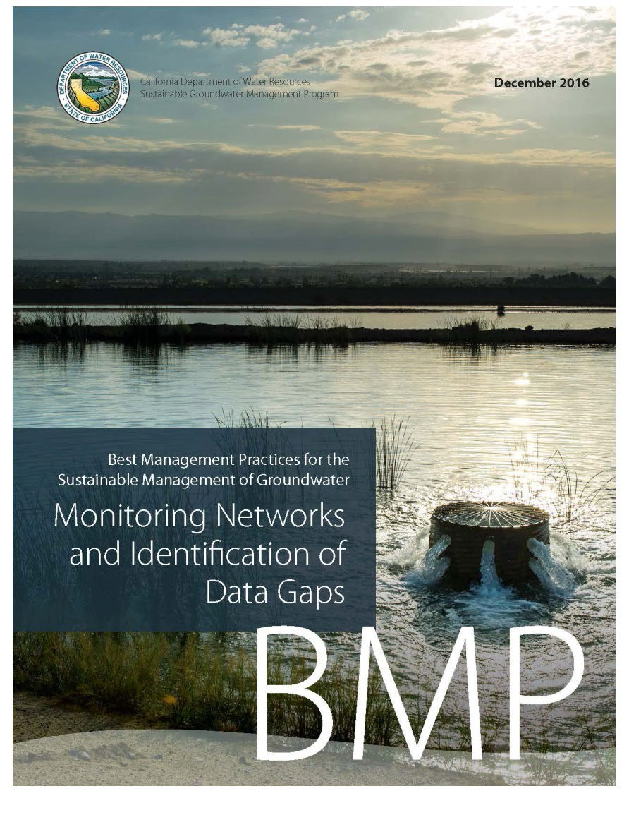
The Monitoring Network will be the key Tool to Demonstrate Sustainability
Build on existing monitoring networks
Select appropriate monitoring points for representative sampling
Identify large gaps to be filled during implementation
We need stakeholder input and engagement!
8

Slide 32
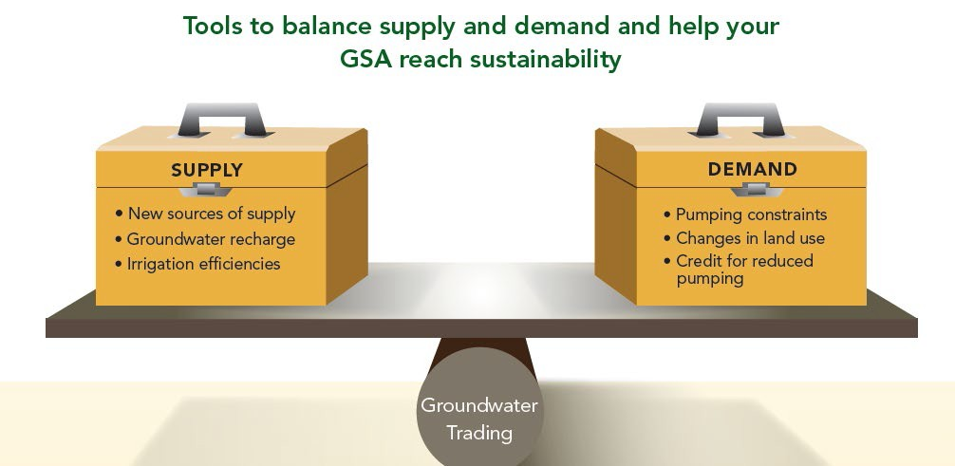
The Big Picture – opportunities and challenges for Groundwater Sustainability Agencies (GSAs)
Tools for GSAs: manage demand or manage supply
Groundwater Sustainability Plan development and implementation: balancing act – between different interests, between water supply and water demand, between beneficial uses

Slide 33
Putting It All Together
Effective stakeholder engagement
SMC/
Monitoring network/ Actions
Modelling tools and technical expertise
We Need good Communication and Stakeholder Input to Develop a Successful GSP

Slide 34
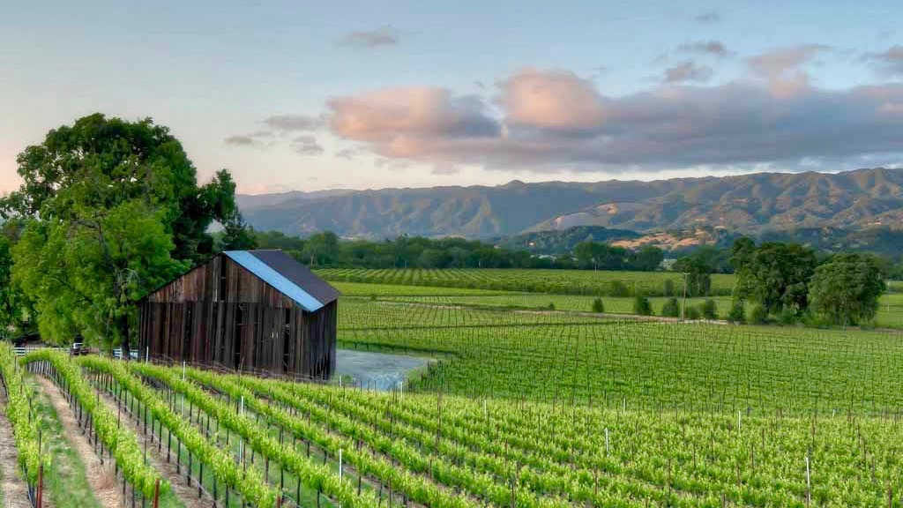






Integrated Model Updates:
PRMS Rainfall Runoff Watershed Model
Streamflow Routing (SFR) in the MODFLOW Groundwater Model
ET
Rainfall
Watershed runoff
to streams
Surface flow
IDC or GSFLOW
Agriculture Model
ET
ET demand for crops is met by irrigation with groundwater or surface water
Surface and groundwater flows
Surface and groundwater flows
Surface Water and Groundwater available for Urban and Domestic Use
Surface Water and Groundwater available for Agricultural Use

Slide 35
Q&A
Ukiah
Public
SGMA

Slide 36
Next Steps

Slide 37
  Planned Next Steps and Schedule
Task | Estimated Completion Time
Additional Model Components Development | October 2020
Model Calibration | November 2020
Historical and Projected Water Budgets | November 2020
Future Scenarios Analysis | Nov-May 2021
Sustainable Yield Analysis | January 2020
Monitoring Network Evaluation | March 2021
Projects and Management Actions | May 2021

Slide 38
  Next Community Public Meeting Possible Topics of Discussion
Integrated Model: Results and Calibration
Historical and current water budgets
Future water budget and future scenario generation
Sustainable Management Criteria Development Process

Slide 39
Questions?
Ukiah
Public
SGMA
Thank you!

